Slide 1

Challenge 1: AI-Driven Literature Search in Molecular Biology and Pharmacology
Teams 2 & 3

Slide 2
Methodology
1- Collecting data from the literature
2- Selection of pre-trained model
3- Fine-Tuning
4- Evaluation

Slide 3
Step1: Collecting data
Collecting AOP and MIE
1- Derive the IUPAC name of compound from PubMed
2- Run IUPAC name on aopkb.oecd.org to get AOP
3- Run AOP on aopwiki.org to get MIE

Slide 4
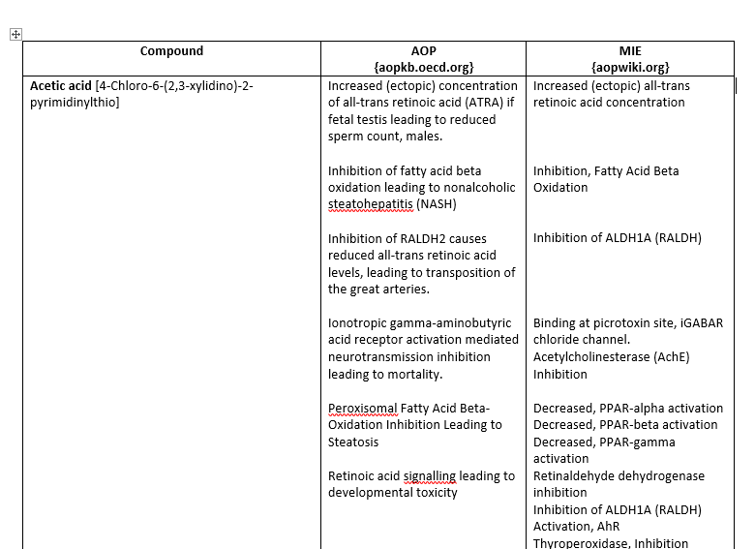
Example

Slide 5
Use PubMed Database
Retrieve articles with keywords such as: ‘compound name’ AND ’molecular target’ OR ‘compound name’ AND ‘protein binding’
From abstract of the selected articles, we used ChatGPT to understand the mode of interaction with targets
Excel file was generated, and data were included

Slide 6
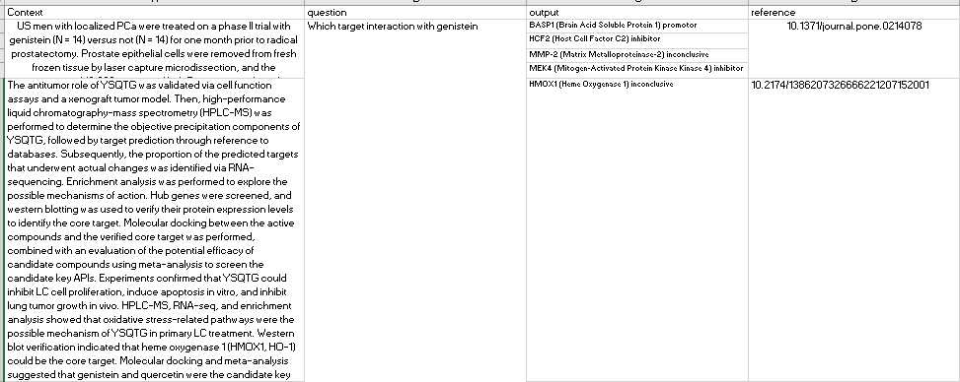
Example

Slide 7
Step 2: Selection of pre-trained model and tokenization
Task description: Text generation
Recommended model is GPT2 from Hugging face transformers
Size 1024 token

Slide 8
Step 2: Selection of pre-trained model and tokenization
Environment preparation : (Anaconda, Pytorch, Hugging face transformers installation)
Data Preprocessing:
Loaded the pre-trained GPT-2 model and tokenizer.
Imported the CSV file (dataset) and extracted the required columns.
Tokenized the input and output text.
Settled a specific maximum sequence length.
Added padding tokens to sequences that are shorter than max_seq_length.
Saved the preprocessed data to a text file.

Slide 9
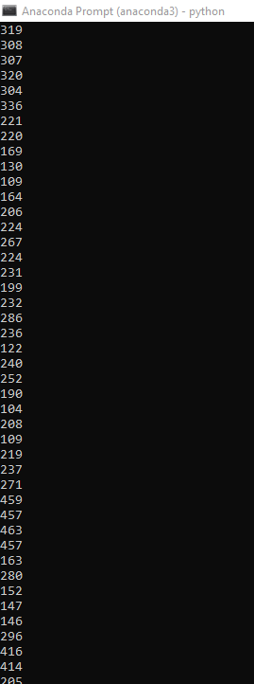
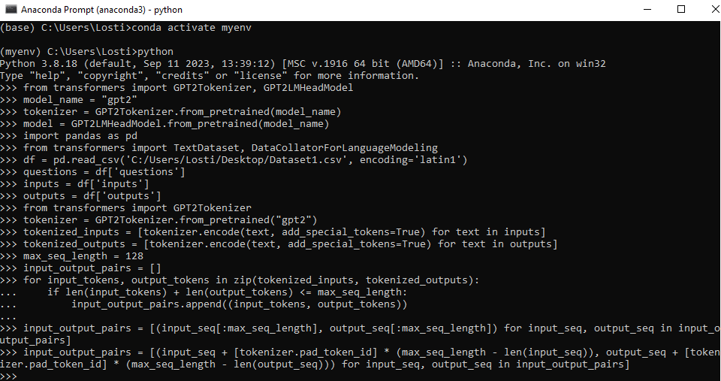
Steps:

Slide 10
Step 3: Fine-Tuning
Fine-Tuning GPT-2:
Defined the training arguments, such as output directory, batch size, training steps, and learning rate.
Created a TextDataset and a DataCollatorForLanguageModeling.
Initialized a Trainer with the model, training arguments, and datasets.
Fine-tuned the GPT-2 model on the already preprocessed data.

Slide 11
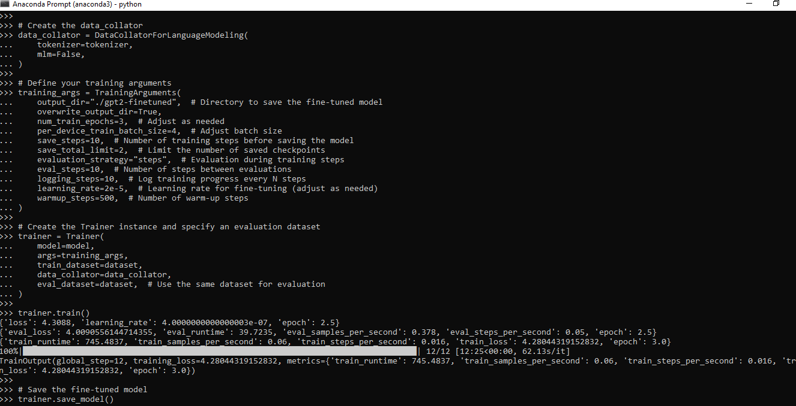

Slide 12
Step 4: Evaluation
Loaded the fine-tuned GPT-2 model and tokenizer.
Defined an input text as an example.
Tokenized the input text and create an attention mask.
Generated text using the fine-tuned model based on the input prompt.

Slide 13
